Slide 1


Team 1
Line Follower Robot

Slide 2
Line Follower Robot
Microcontroller
Arduino
Power
Power Distribution
IR sensor
Motor driver
Signal sensor
Movement controller

Slide 3

L293D Motor Driver

Slide 4
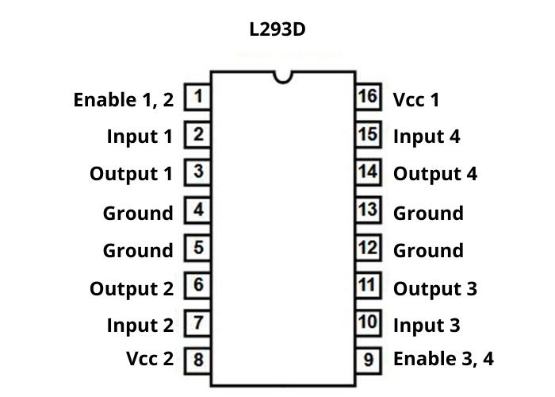
L293D Motor Driver
Pins Diagram
Enable 1,2
Controlling Motor 1 Speed
Input 1, Input 2
Controlling Motor 1 Direction
Output 1, Output 2
Connected to the controlled
motor
Vcc2
The voltage required for
the motors to work
4.5V:36V
Enable 3,4
Controlling Motor 2 Speed
Input 3, Input 4
Controlling Motor 2 Direction
Output 1, Output 2
Connected to the controlled
motor
Vcc1
5V for internal logic translation

Slide 5
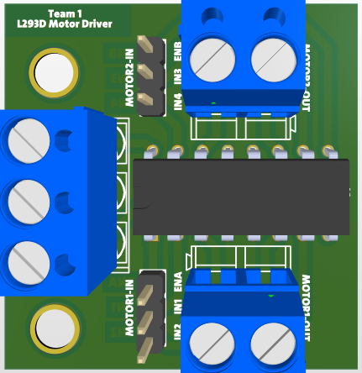
L293D Motor Driver
PCB
Motor #2 Controlling Data
In3, in4 -> direction
ENB -> speed
Controlled Motor #2
Fastening Holes
L293D IC
Power for circuit’s
Components
+5V, 0V, +12V
Motor #1 Controlling Data
In1, in2 -> direction
ENA -> speed
Controlled Motor #1

Slide 6

IR Sensor

Slide 7
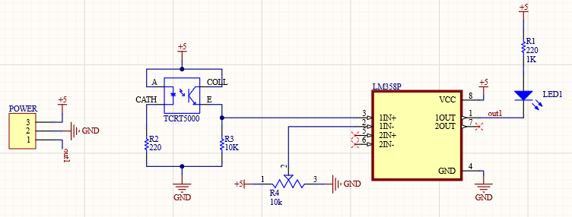
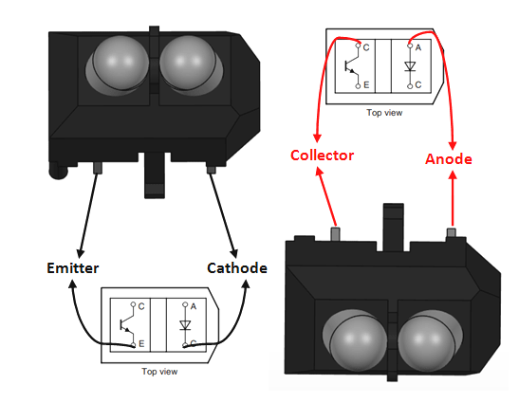
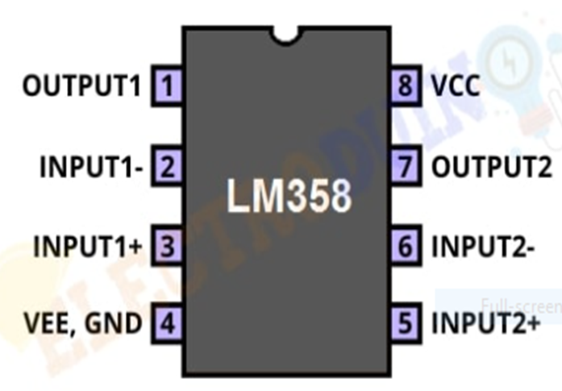
TCRT5000 Sensor
Schematic circuit of TCRT5000
TCRT5000 sensor
LM358 OP-amp

Slide 8
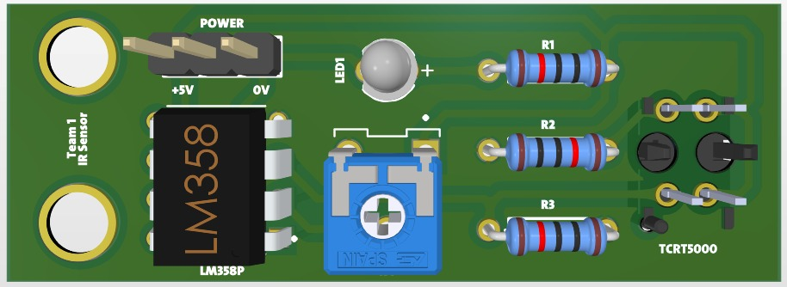
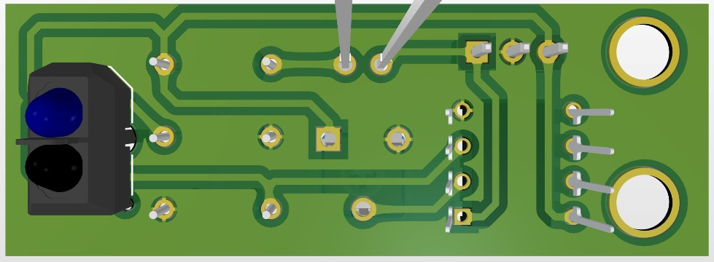
PCB
Top layer
Bottom layer
Pin header
LM358
led1
V-R
R1
Tcrt5000
R3
R2

Slide 9

Power Distribution

Slide 10
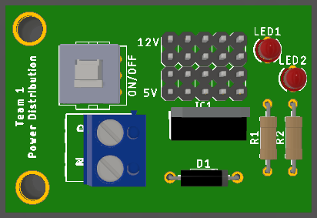
Power Distribution
On/Off Switch
Output 12V, 5V
Output Indicating
LEDs
Fastening Holes
V-Reg 7805
Input 12V
Prevent Wrong
Connection
Distributes Batteries power in order to be able to operate all robot’s parts
with the same battery

Slide 11

Arduino Code

Slide 12
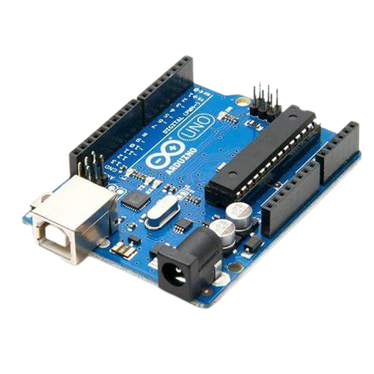
Arduino UNO
14 Digital I/O pins
(of which 6 provide PWM output)
Maximum input current 20mA
Maximum output current
40mA
6 analog input pins
Operating volte 5V
Three power ways
Input voltage
(recommended) 7-12V
Input voltage (limits) 6-20V
Clock speed 16MHz
Microcontroller ATmega328

Slide 13
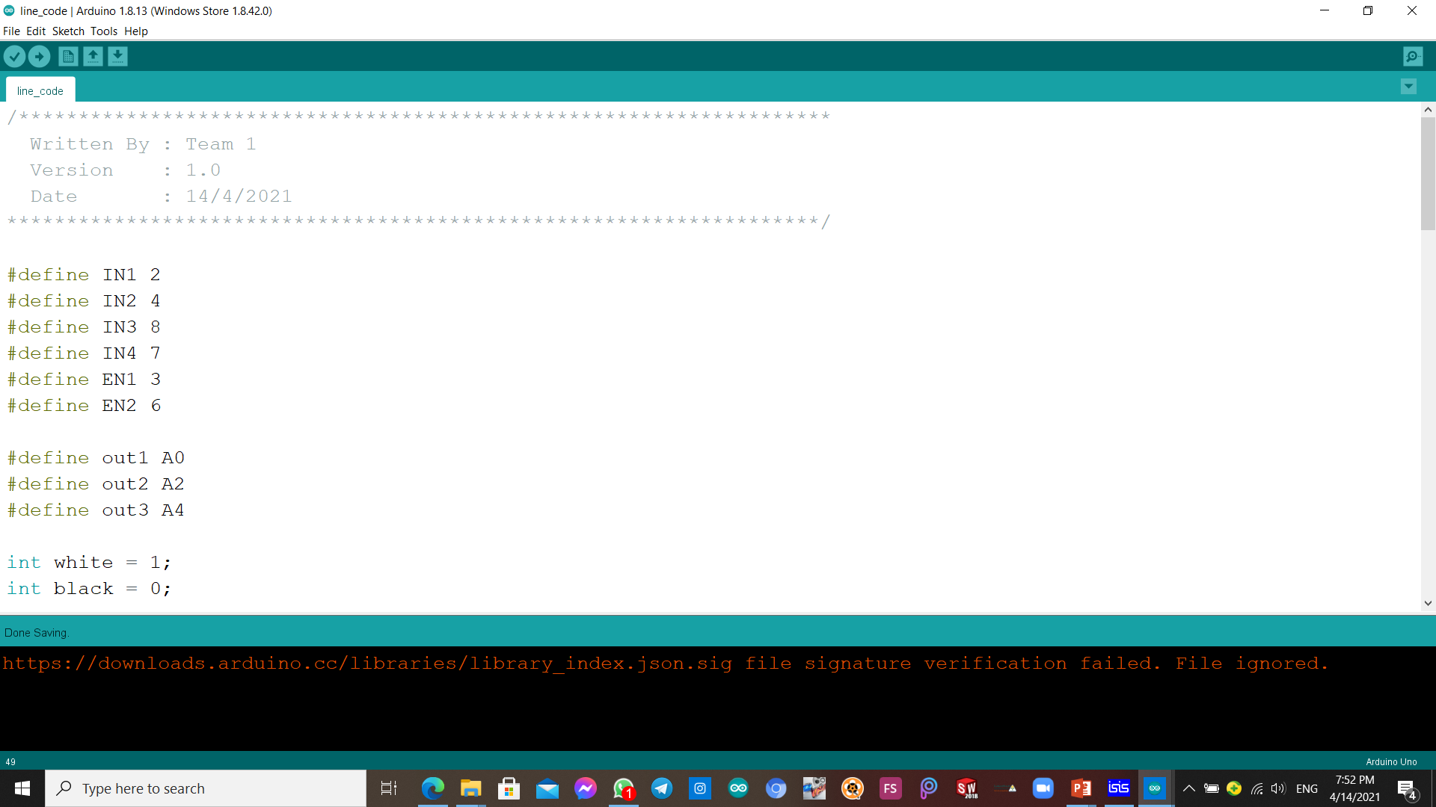
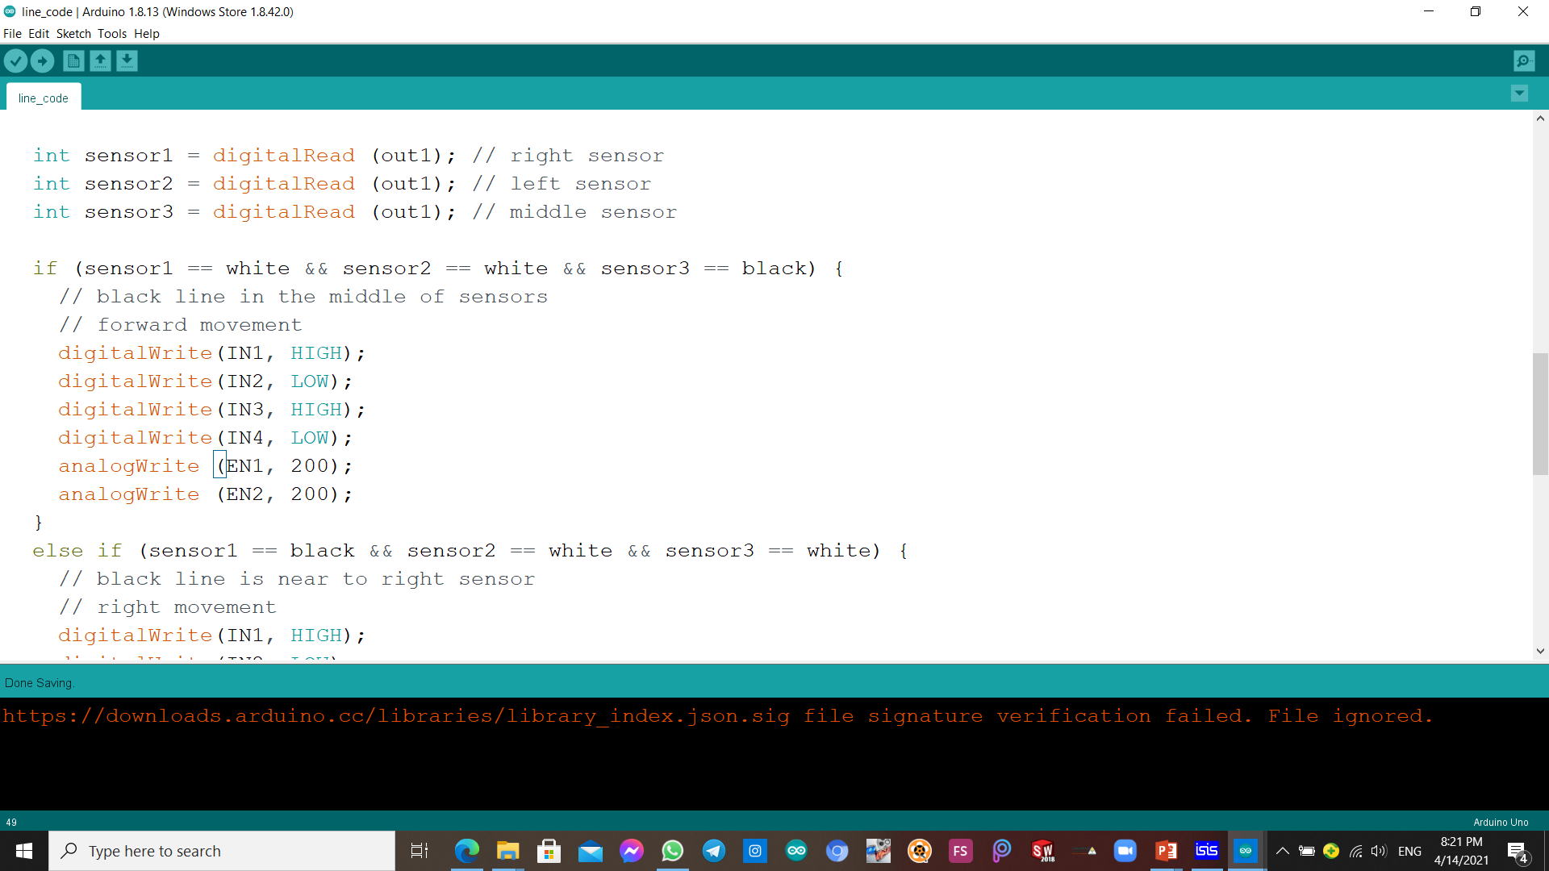
Showing motors pins, sensors pins and define them
Movement functions
( showing how to control robot movement )

Slide 14

Final Result

Slide 15
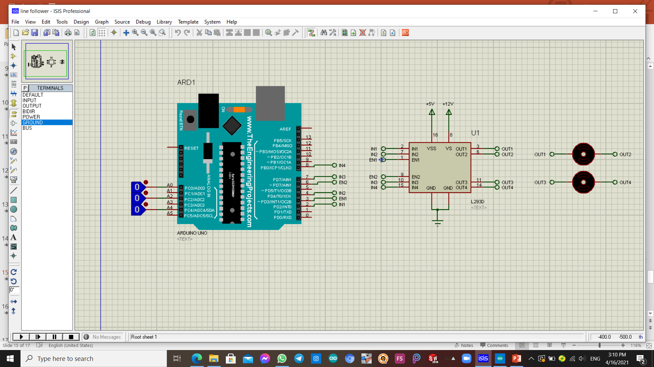
Simulation schematic circuit
Due to error in the downloaded sensor's library we replaced it in the simulation with logic states

Slide 16
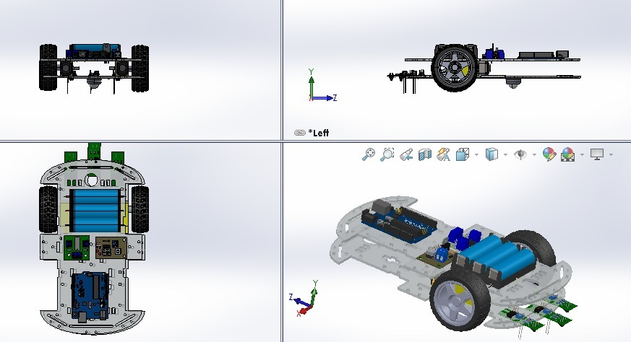
Robot chassis

Slide 17
Thank you

